Slide 1
One Way Anova

Slide 2
Introduction
There are many situations where you need to compare the mean between multiple groups.
For instance, the marketing department wants to know if three teams have the same sales performance.
Team: 3 level factor: A, B, and C
Sale: A measure of performance
The ANOVA test can tell if the three groups have similar performances.

Slide 3
Hypothesis in one-way ANOVA test
H0: The means between groups are identical
HA: At least, the mean of one group is different
Assumptions
We assume that each factor is randomly sampled, independent and comes from a normally distributed population with unknown but equal variances

Slide 4
Here, we’ll use the built-in R data set named PlantGrowth. It contains the weight of plants obtained under a control and two different treatment conditions.

Slide 5
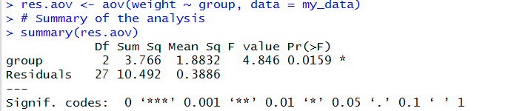

Slide 6
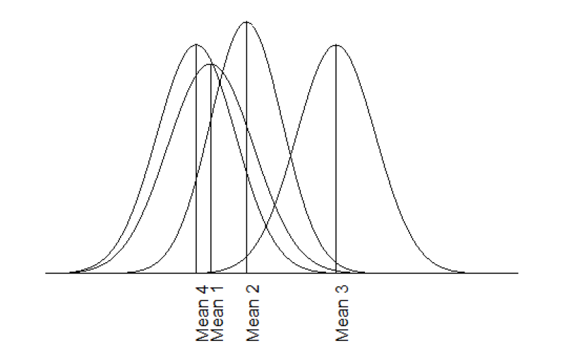

Slide 7
Suppose a salesperson wants to compare the level of satisfaction of customers for four difference insurance companies.
Our question is:
"Is there a difference in satisfaction scores across the four difference insurance companies?”

Slide 8
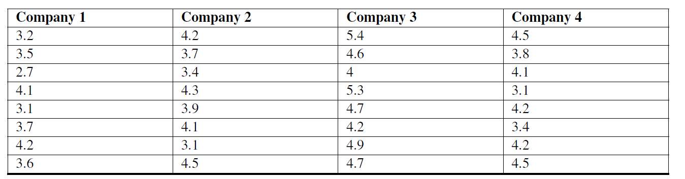
Mean company 1 =4
Mean company =3

Slide 9
The Null and Alternative hypotheses for a one-way ANOVA can be written as:
H0 : Means of all groups are equal
HA : At least group level has a different mean

Slide 10
In ANOVA method, we analyze the total variation of the scores, including the variation of the scores within the groups and the variation between the group means.
Since we are interested in two different types of variation, we first calculate each type of variation independently and then calculate the ratio between the two –called an F-value.
Just like our z-score, our t-test, and chi-square tests, ANOVA has its own distribution that we need to use, called an F-distribution to set our critical values and test our hypothesis.

Slide 11
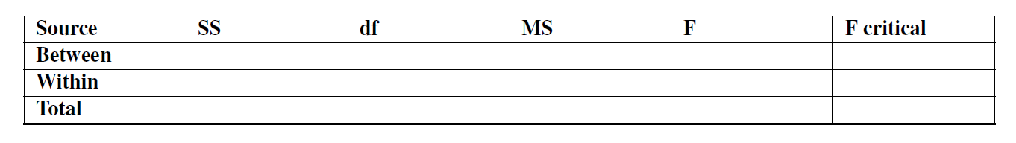

Slide 12

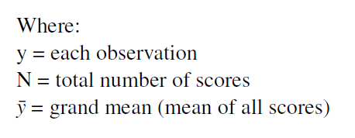
Calculate the total sum of squares (SST ). This is the difference between each score and the grand mean.
We use the following formula:
SST = Summation((Y-grand mean y)^2)

Slide 13
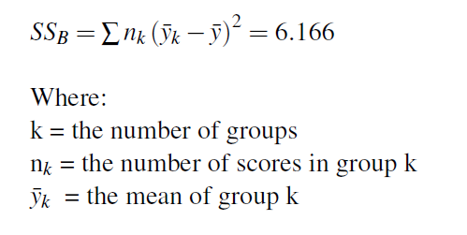
Calculate the sum of squares between (SSB).
We use the following formula:

Slide 14
SSW = summation( score company1- mean company 1))+

Slide 15
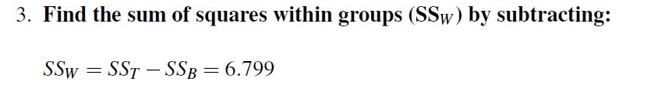
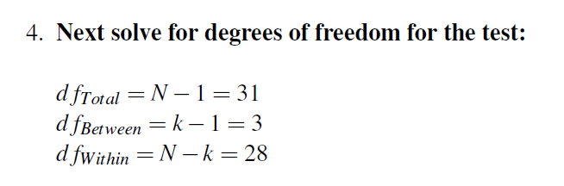

Slide 16
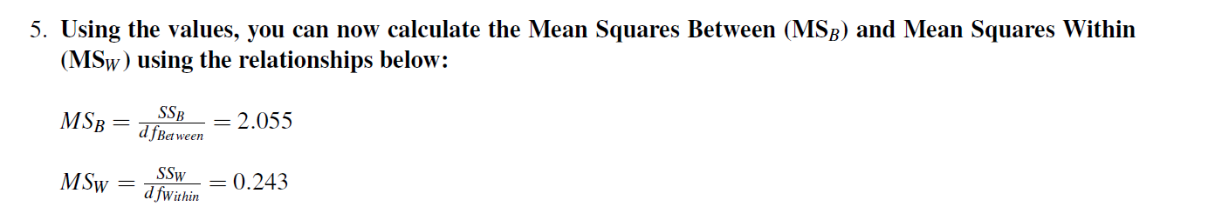
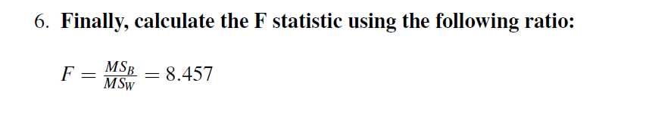

Slide 18
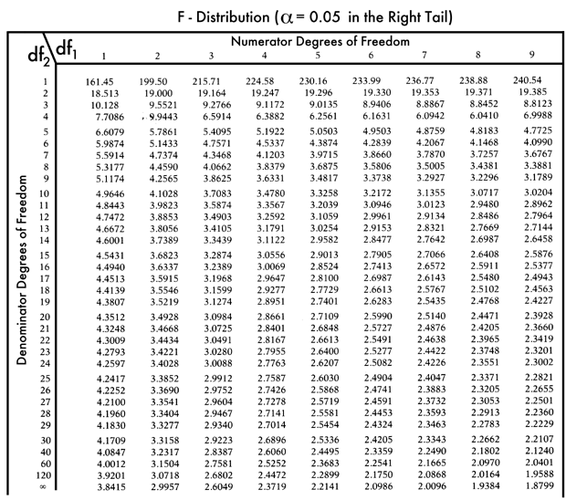

Slide 19
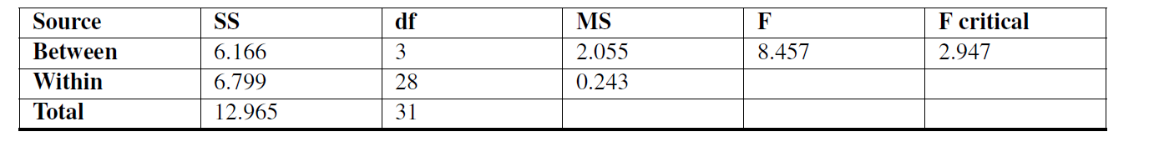
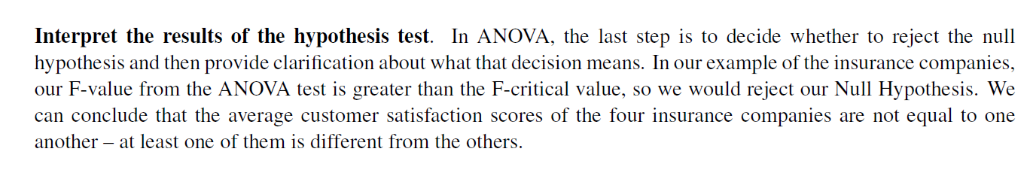

Slide 20
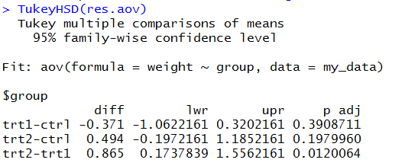
Where the difference in the sample means lies
If we have an ANOVA that rejects the Null Hypothesis we must find out where the difference lies –what group or groups are difference from one another.
To do this we use a post-hoc test.

Slide 21
#Is there difference in sepal length between flowers?
data(iris)
your.aov = aov(iris$Sepal.Length ~ iris$Species)
summary(your.aov)
#which flower how much different?
TukeyHSD(your.aov)
aggregate(Sepal.Length~Species, data=iris, mean)

